Slide 1

Panasonic Manufacturing Philippines Corporation
AUTOMATION SYSTEM

Slide 2
Proposal: MONITORING SYSTEM
Purpose[System Requirements]:
Design a real-time monitoring system for production line.
Display Production line status and machine status.
System must be future improvement ready.

Slide 3
Proposal: AUTOMATION SYSTEM
JOB DESCRIPTION
MINDS | PANASONIC
1. PROVIDE ELECTRICAL COMPONENTS (PLC, DISPLAY MONITOR, PC , HMI AND OTHER ACCESSORIES). | 1. PROVIDE SUPPORT DURING INSTALLATION.
2. CREATE AND PROVIDE ELECTRICAL DIAGRAM. | 2. PROVIDE THE PROCESS FLOW OF THE REQUIREMENT.
3. CREATE AND PROVIDE OPERATION MANUAL. | 3. EVALUATE THE SYSTEM.
4. INSTALLATION OF NEW SYSTEM.
FUNCTION
FUNCTION
DISPLAY THE FOLLOWING:
PRODUCTION OUTPUT COUNT
CYCLE TIME
2. INPUT PRODUCTION PARAMETERS IN HMI.
3. REAL-TIME MONITORING DISPLAY.

Slide 4
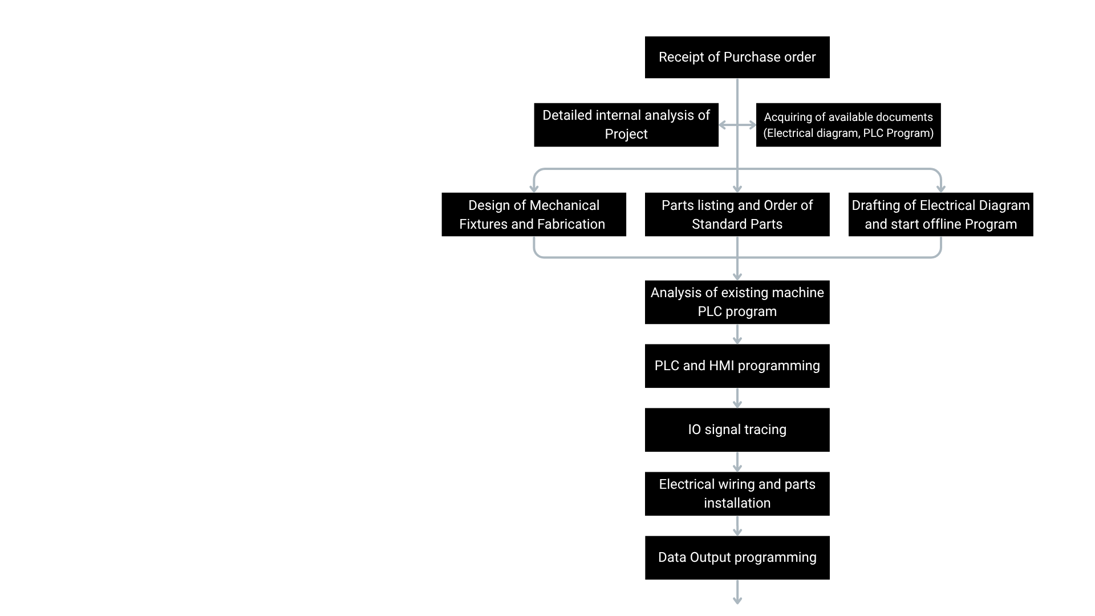
Proposal: AUTOMATION SYSTEM
Project sequence of work overview
Receipt of Purchase Order
Project starts upon receiving the PO.
Internal Project Analysis
Review requirements and gather available documents.
Concurrent Activities
These three steps run in parallel:
  Mechanical Design & Fabrication – Create and build mechanical fixtures.
  Parts Listing & Procurement – List required parts and process orders.
  Electrical Diagram & Offline Programming – Draft diagrams and begin initial PLC programming.
Existing PLC Program Analysis
Study current machine logic for proper integration.
PLC & HMI Programming
Develop or update PLC and HMI functions.
Electrical Installation
Install wiring and electrical components.
Data Output Programming
Finalize data handling and output functions.

Slide 5
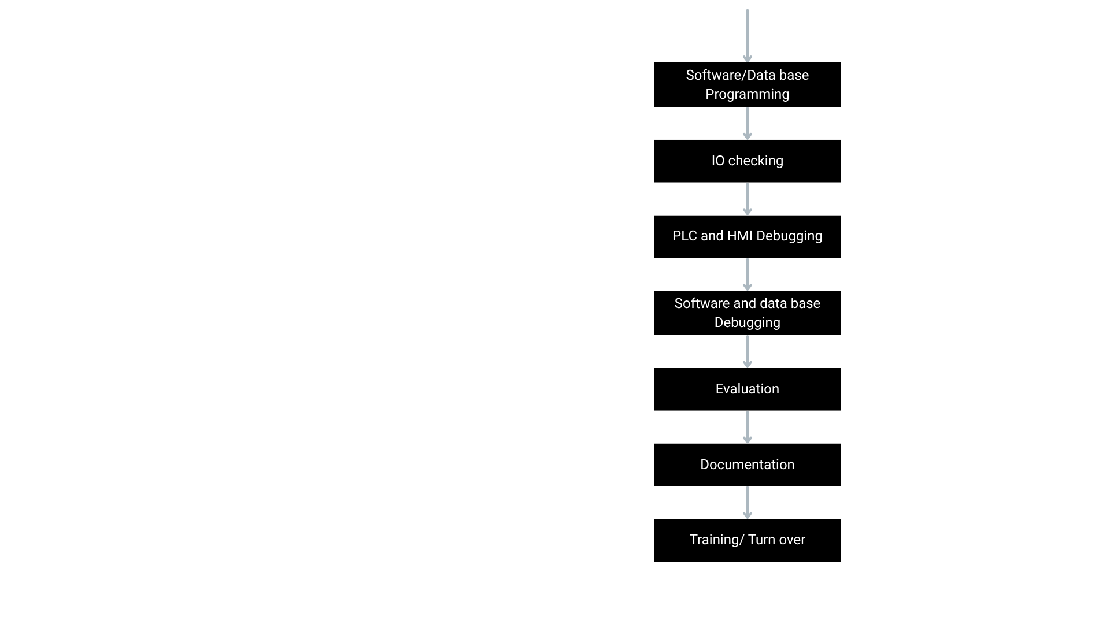
Proposal: AUTOMATION SYSTEM
Project sequence of work overview
Software / Database Programming
Develop required software functions and database structures for the system.
IO Checking
Verify all customer machine IO points for correct wiring and signal behavior.
PLC and HMI Debugging
Test and refine PLC and HMI logic to ensure proper machine operation.
Software and Database Debugging
Troubleshoot and finalize software and database interactions.
Evaluation
Assess overall system performance and verify that all functions meet project requirements.
Documentation
Prepare the necessary manuals, diagrams, and project documentation.
Training / Turnover
Conduct end-user training and officially hand over the system.

Slide 6
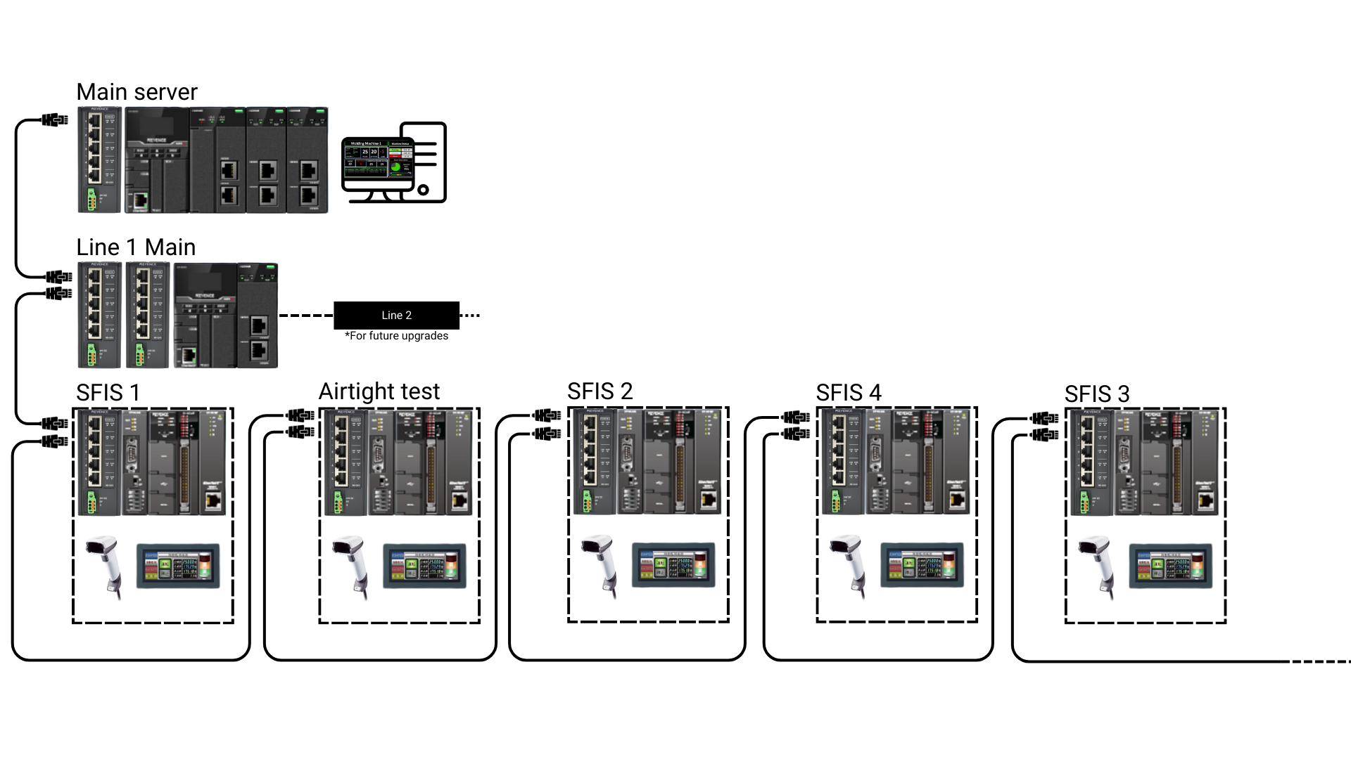
Proposal: AUTOMATION SYSTEM
SET-UP
MAIN SERVER
LINE 1 MAIN
ITEM | MODEL | QTY
POWER SUPPLY | MS2 series | 1
Programmable Logic Controller (PLC) | KV-8000 series | 1
PLC communication unit | KV series | 1
PLC data utilization unit | KV series | 1
PLC ethernet unit | KV series | 1
Ethernet hub | NE series | 1
ITEM | MODEL | QTY
POWER SUPPLY | MS2 series | 1
Programmable Logic Controller (PLC) | KV-8000 series | 1
PLC ethernet unit | KV series | 1
Ethernet hub | NE series | 1

Slide 7
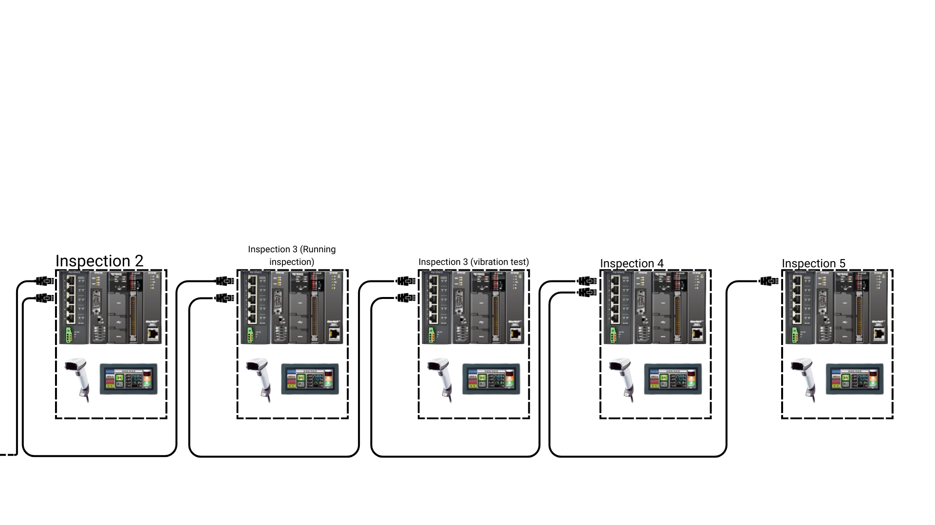
Proposal: AUTOMATION SYSTEM
SET-UP
SUB CONTROL BOX COMMON ITEMS
ITEM | MODEL | QTY
POWER SUPPLY | MS2 series | 10
Programmable Logic Controller (PLC) | KV-Nano series | 10
PLC Ethernet unit | KV series | 10
PLC Serial unit | KV series | 10
Touch Panel | VT3 series | 10
Barcode scanner | HR series | 10
Ethernet hub | NE series | 10

